Slide 1
OOPS PROJECT
By Munish Patwa

Slide 2
CONTENTS
1 Problem Definition
2 Abstract
3 Tools Used
4 Explanation
5 Output
6 Conclusion

Slide 3
PID 063
A proposed system should
generate zone of consideration (list of eligible employees) based on seniority list and employees’ performance appraisal data for last 5 years by integrating all the rules. System should generate draft of final orders of selected employees in prescribed format
PROBLEM DEFINITION

Slide 4
Abstract
We have to create a java program in which we insert employee data and based on eligibility criteria we insert the employee data into promotion table for who are eligible for promotion

Slide 5
TOOLS USED
VS CODE
JAVA Language
JDBC Extension
MySQL WORKBENCH

Slide 6
CODE
import java.sql.Connection;
import java.sql.DriverManager;
import java.sql.ResultSet;
import java.sql.SQLException;
import java.sql.Statement;
import java.util.*;
public class Javaproject
{
static final String DB_URL="jdbc:mysql://localhost:3306/";
static final String USER = "root";
static final String PASS = "Mun20ish03@";
public static void main(String[] args)
{
int ch;
Scanner cin = new Scanner(System.in);
try(Connection conn = DriverManager.getConnection(DB_URL, USER, PASS);
Statement stat = conn.createStatement();)
{
String sql1 ="USE javaproj";
stat.execute(sql1);

Slide 7
catch(SQLException e)
{
e.printStackTrace();
}
}
}

Slide 8
EXPLANATION
First we Import all the SQL Modules
Then we try to create connection with database in main class in try block if error occurs we catch it
String URL specifies the connection host
String user says we are using the root user
And String password is the password for the connction

Slide 9
try(Connection conn = DriverManager.getConnection(DB_URL, USER, PASS);
Statement stat = conn.createStatement();)
Here we make a connection in try block and catch the exception if occurs
Statement stat is used to execute queries
Eg stat.execute(string);

Slide 10
We have a choice based application
In 1st choice we insert data into employee table
In 2nd choice we can update employee data
In 3rd choice we Can see the employee table
In 4th we can see the employee eligible for promotion
In 5th we delete a record
Explanation

Slide 11
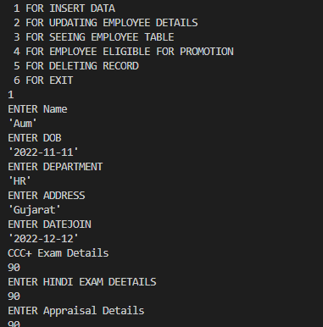
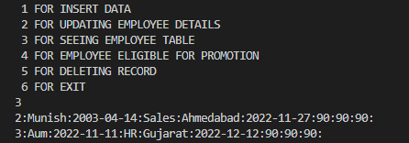
OUTPUT

Slide 12
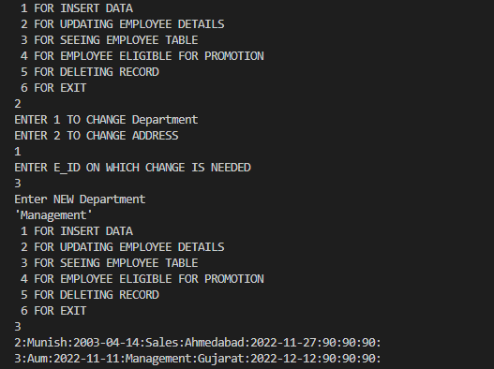
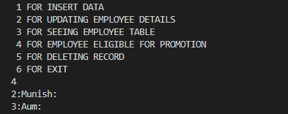
OUTPUT

Slide 13
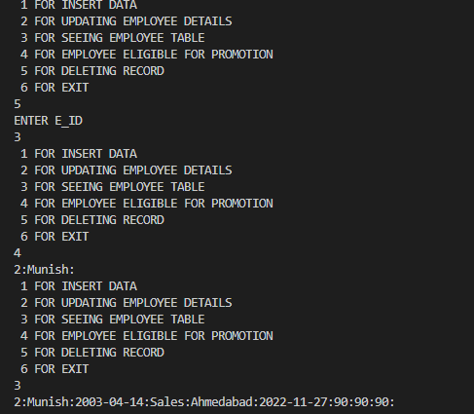
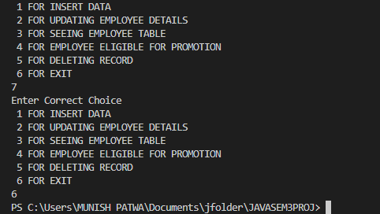
OUTPUT

Slide 14
We were able to create the project using Java and MySQL workbench
We made the connection between them through JDBC. And successfully get the employee eligible for promotion
Conclusion

Slide 15
THANK YOU
Munish Patwa
21162121017
BDA BATCH 33

